Slide 1

A Survey on Virtualization Technologies

Slide 2
Virtualization is “HOT”
Microsoft acquires Connectix Corp.
EMC acquires VMware
Veritas acquires Ejascent
IBM, already a pioneer
Sun working hard on it
HP picking up
➔Virtualization is HOT!!!

Slide 3
Veritas/Ejascent
Veritas Cluster Server
  Integrates the Ejascent’s Application Virtualization software
  Enables cluster server users to move data seamlessly across applications without disrupting the transaction state

Slide 4
Virtualization: What is it, really?
Real vs. Virtual
  Similar essence, effect
  ”Formally” different
A framework that combines or divides [computing] resources to present a transparent view of one or more environments
  Hardware/software partitioning (or aggregation)
  Partial or complete machine simulation
  Emulation (again, can be partial or complete)
  Time-sharing (in fact, sharing in general)
  In general, can be M-to-N mapping (M “real” resources, N “virtual” resources)
  Examples: VM (M-N), Grid Computing (M-1) , Multitasking (1-N)

Slide 5
Virtualization: Why?
Server consolidation
Application Consolidation
Sandboxing
Multiple execution environments
Virtual hardware
Debugging
Software migration (Mobility)
Appliance (software)
Testing/Quality Assurance

Slide 6
Virtual Machine Implementation: Issues
Only one “bare” machine interface
Virtualizable Architecture
  “A virtualizable architecture allows any instruction inspecting/modifying machine state to be trapped when executed in any but the most privileged mode”
  - Popek & Goldberg (1974)
X86 is not virtualizable (Vanderpool??)
Hard to optimize [from below]
  Unused memory pages
  Idle CPU
Difficult to know what NOT to do
  Example: Page faults (VMM), System Calls (OS level)

Slide 7
Example
X86 Instruction: STR (gets security state)
  Value retrieved has the Requester Privilege Level
  Thus, behavior depends on the privilege level
  ➔Problematic
X86 has at least 17 such instructions

Slide 8
Machines: Stacked Architecture
APPLICATIONS
API Calls
USER LEVEL LIBRARIES
User Space
System Calls
Kernel Space
KERNEL
Instructions
HARDWARE

Slide 9
Possible Abstraction Levels
Instruction Set Architecture
  Emulate the ISA in software
    Interprets, translates to host ISA (if required)
    Device abstractions implemented in software
    Inefficient
  Optimizations: Caching? Code reorganization?
  Applications: Debugging, Teaching, multiple OS
Hardware Abstraction Layer (HAL)
  Ring Compression
  Between “real machine” and “emulator” (maps to real hardware)
  Handling non-virtualizable architectures (scan, insert code?)
  Applications: Fast and usable, virtual hardware (in above too), consolidation, migration

Slide 10
Possible Abstraction Levels cont’d
Operating System Level
  Virtualized SysCall Interface (may be same)
  May or may not provide all the device abstractions
  Easy to manipulate (create, configure, destroy)
Library (user-level API) Level
  Presents a different subsystem API to application
  Complex implementation, if kernel API is limited
  User-level device drivers
Application (Programming Language) Level
  Virtual architecture (ISA, registers, memory, …)
  Platform-independence (➔ highly portable)
  Less control on the system (extremely high-level)

Slide 11
Overall Picture
 | ISA | HAL | OS | Library | PL
Performance | * | **** | **** | *** | **
Flexibility | **** | *** | ** | ** | **
Ease of Impl | ** | * | *** | ** | **
Degree of Isolation | *** | **** | ** | ** | ***
(more stars are better)

Slide 12
Instruction Set Architecture Level Virtualization
Technologies
  Emulation: Translates guest ISA to native ISA
  Emulates h/w specific IN/OUT instructions to mimic a device
  Translation Cache: Optimizes emulation by making use of similar recent instructions
  Code rearrangement
  Speculative scheduling (alias hardware)
Issues
  Efficient Exception handling
  Self-modifying code

Slide 13
ISA Level Virtualization: Examples
Bochs: Open source x86 emulator
  Emulates whole PC environment
    x86 processor and most of the hardware (VGA, disk, keyboard, mouse, …)
    Custom BIOS, emulation of power-up, reboot
    Host ISAs: x86, PowerPC, Alpha, Sun, and MIPS
Crusoe (Transmeta)
  “Code morphing engine” – dynamic x86 emulator on VLIW processor
  16 MB “translation cache”
  Shadow registers: Enables easy exception handling
QEMU:
  Full Implementation
    Multiple target ISAs: x86, ARM, PowerPC, Sparc
    Supports self-modifying code
    Full-software and simulated (using mmap()) MMU
  User-space only: Useful for Cross-compilation and cross-debugging

Slide 14
Virtualization through Ring Compression
Virtual Machine Monitor (VMM) runs at ring 0
Kernel(s) run at
ring 1
Requires that CPU
is virtualizable
3
user
kernel
2
1
0
VMM

Slide 15
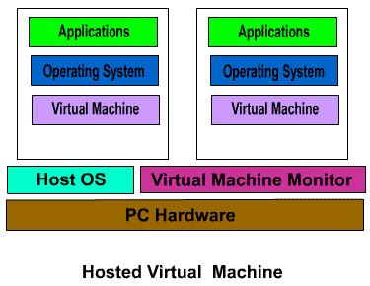
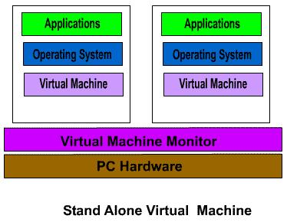
HAL Virtualization Techniques
Standalone vs. Hosted
  Drivers
  Host and VMM worlds
  I/O
Protection Rings
  Multilevel privilege domains
Handling “silent” fails
  Scan code and insert/replace artificial traps
  Cache results to optimize

Slide 16
Classification of processor architectures
Strictly virtualizable processor architectures
  Can build a VMM based on trap emulation exclusively
    No software running inside the VM cannot determine the presence of the VMM (short of timing attacks)
  Examples: IBM S/390, DEC Compaq Intel Alpha, PowerPC
(Non-strictly) virtualizable processor architectures
  Trap emulation alone is not sufficient and/or not complete
    E.g. instructions have different semantics at various levels (sufficient)
    E.g Some software sequences can determine the presence of the VMM (complete)
  Examples: IA-32, IA-64
Non virtualizable processor architectures
  Basic component missing (e.g. MMU, …)

Slide 17
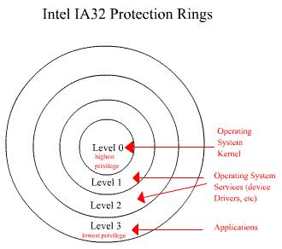

Slide 18
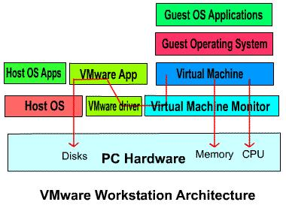
VMware Architecture

Slide 19
VMware: I/O Virtualization
VMM does not have access to I/O
I/O in “host world”
  Low level I/O instructions (issued by guest OS) are merged to high-level I/O system calls
  VM Application executes I/O SysCalls
VM Driver works as the communication link between VMM and VM Application
World switch needs to “save” and “restore” machine state
Additional techniques to increase efficiency

Slide 20
